Slide 1
CSE 1321 Modules 1-5 Review
Fall 2019
Notes:
Introduce yourself and welcome the students

Slide 2
Module 1 Algorithms and Abstraction
Algorithms are:
A set of logical steps to accomplish a specific task
A set of direction/instructions
Abstraction is:
LOGICAL GROUPING of concepts or objects
Hide the details (in functions or methods)
We like to think at a high level of abstraction (no details)
Too many details overwhelm us!

Slide 3
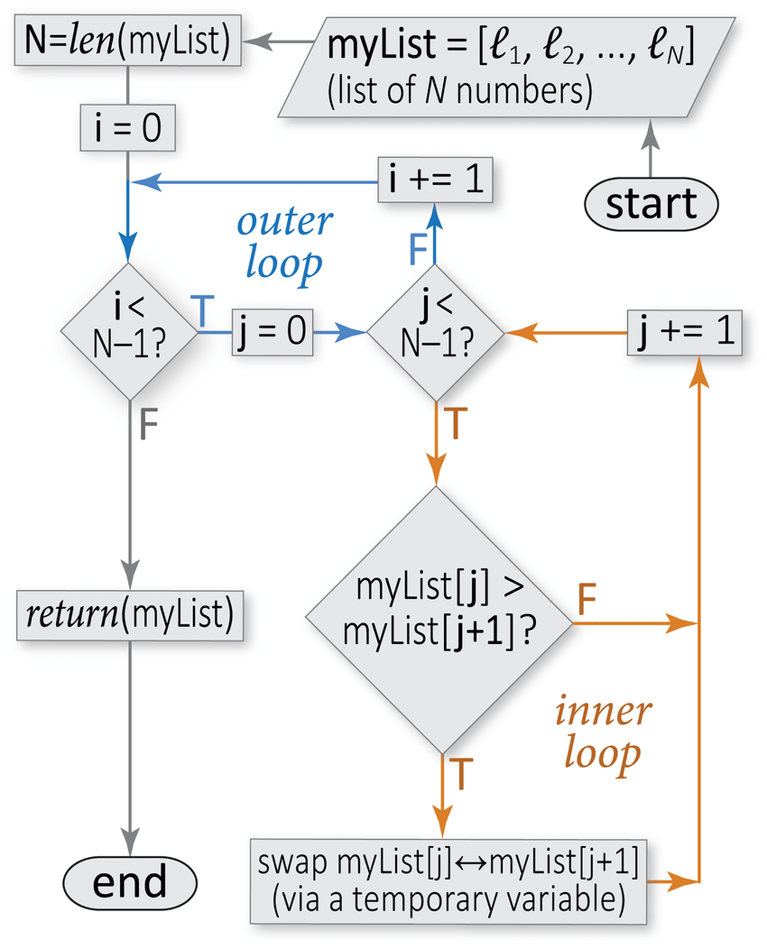
Algorithm in a Flowchart for Sorting
Sample flowchart for a sorting algorithm. This flowchart illustrates the conditional constructs, loops, and other elements of control flow that comprise an algorithm for sorting, from smallest to largest, an arbitrary list of numbers (the algorithm is known as “bubble sort”). In this type of diagram, arrows symbolize the flow of logic (control flow), rounded rectangles mark the start and end points, slanted parallelograms indicate I/O (e.g., a user-provided list), rectangles indicate specific subroutines or procedures (blocks of statements), and diamonds denote conditional constructs (branch points). Note that this sorting algorithm involves a pair of nested loops over the list size (blue and orange), meaning that the calculation cost will go as the square of the input size (here, an N-element list); this cost can be halved by adjusting the inner loop conditional to be “”, as the largest i elements will have already reached their final positions
Image and Text from https://www.researchgate.net/figure/Sample-flowchart-for-a-sorting-algorithm-This-flowchart-illustrates-the-conditional_fig7_303337342

Slide 4
Pseudocode Skeleton
Ps
BEGIN MAIN
END MAIN
Note: every time you BEGIN something, you must END it!
Write them as pairs!

Slide 5

C# Skeleton
using System;
class MainClass
{
public static void Main (string[] args)
{
}
}
Note: The opening “{“ means BEGIN
and the closing “}” means END

Slide 6

Java Skeleton
class MainClass
{
public static void main (String[] args) {
}
}
Note: Capitalization matters!

Slide 7

C++ Skeleton
#include <iostream>
int main ()
{
return 0;
}

Slide 8
Pseudocode Variables & Input
Ps
BEGIN MAIN
CREATE inputNum
PRINT(“Please enter a number: “)
inputNum ← READ from user input
END MAIN

Slide 9
C# Variables & Input
using System;
class main
{
public static void Main(String[] args)
{
Console.Write("Please enter a integer: ");
int inputNum = Convert.ToInt16(Console.ReadLine());
}
}

Slide 10
Java Variables & Input
import java.util.Scanner;
public class Main
{
public static void main(String[] args)
{
Scanner input = new Scanner(System.in);
System.out.print("Please enter a integer: ");
int inputNum = input.nextInt();
}
}

Slide 11
C++ Variables & Input
#include <iostream>
#include <string>
using namespace std;
int main ()
{
int inputNum = 0;
cout << "Please enter an integer:";
cin >> inputNum;
return 0;
}

Slide 12
Escape Sequences
Printing and escape sequence prints a special character in an output string.
Common escape sequences:
\b backspace. (e.g “B\bsecz\bret” prints what?)
\t tab
\n newline
\r carriage return
\” double quote
\’ single quote
\\ backslash

Slide 13
Data Types
8 simple data types:
4 subsets of integers (int, long, short, byte)
2 subsets of floating point numbers (float and double)
Character
Boolean
Complex Data Types:
String
Classes
Arrays

Slide 14
CONSTANTS and Literals
CONSTANTS are values that cannot change while the program is running.
E.g.: MAX_WEIGHT = 600
ELEVATOR_LIMIT = 10 * MAX_WEIGHT
Literals are the values that are entered into the code:
E.g. : ELEVATOR_LIMIT = 6000

Slide 15


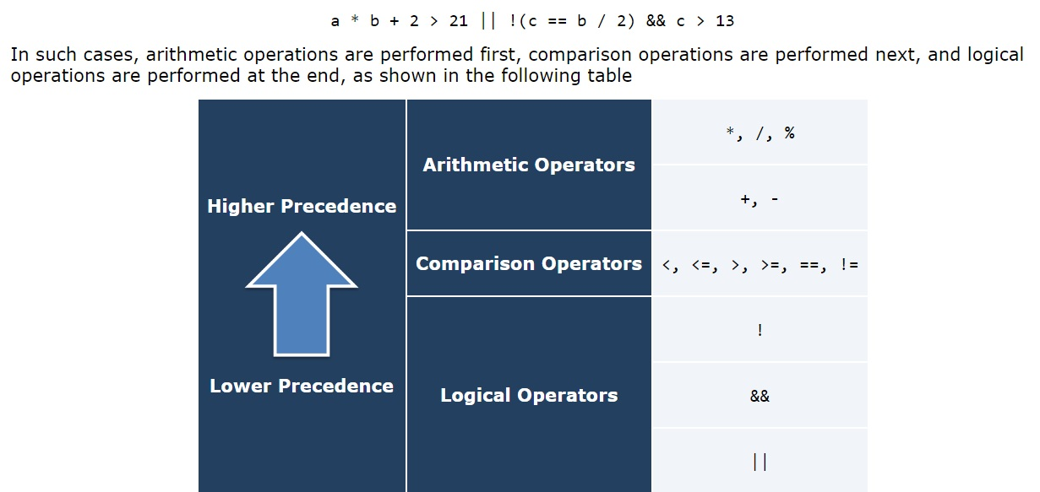
Order of Operations

Slide 16
Shortcut Operators
++ increment by 1
-- decrement by 1
+= Add value on the right of the symbol to the variable on the left and store the result in the variable on the left.
-= Subtract value on the right of the symbol from the variable on the left and store the result in the variable on the left.
*= Multiply the variable on the left by the value on the right of the symbol and store the result in the variable
/= Divide the variable on the left by the value on the right of the symbol and store the result in the variable
%= Divide the variable on the left by the value on the right and store the resulting remainder in the variable.

Slide 17
Relational and Logical Operators
Used to create a true or false expression: Relational:
> greater than
< less than
== equals (note the double equals)
! not
!= not equal
>= greater than or equal
<= less than or equal
Logical:
Logical NOT (only works on one operand)
Logical AND (requires two operands)
Logical OR (requires two operands)
Exclusive OR

Slide 18
IF Statements
Ps
Builds on the Pseudocode from Slide 8
BEGIN MAIN
CREATE inputNum
PRINT(“Please enter a number: “)
inputNum ← READ from user input
IF (inputNum % 2 == 0)
PRINTLINE(“That number is even.”)
END IF
END MAIN

Slide 19
IF-ELSE Statements
Ps
Builds on the Pseudocode from Slide 18
BEGIN MAIN
CREATE inputNum
PRINT(“Please enter a number: “)
inputNum ← READ from user input
IF (inputNum % 2 == 0)
PRINTLINE(“That number is even.”)
ELSE
PRINTLINE(“That number is odd.”)
END IF
END MAIN

Slide 20
IF-ELSE-IF Statements
Ps
Builds on the Pseudocode from Slide 19
BEGIN MAIN
CREATE inputNum
PRINT(“Please enter a number: “)
inputNum ← READ from user input
IF (inputNum % 2 == 0)
PRINTLINE(“That number is even.”)
ELSE IF (inputNum % 2 != 0)
PRINTLINE(“That number is odd.”)
ELSE
PRINTLINE(“You did not enter a number!”)
END IF
END MAIN

Slide 21
SWITCH/CASE Statements
Different approach to the same problem (determining if a number is even or odd)
BEGIN MAIN
CREATE inputNum
PRINT(“Please enter a number: “)
inputNum ← READ from user input
SWITCH(inputNum % 2)
CASE 0: PRINTLINE(“That number is even.”)
BREAK
CASE 1: PRINTLINE(“That number is odd.”)
BREAK
CASE default: (“You did not enter a number!”)
BREAK
END SWITCH
END MAIN
Ps

Slide 22
In-Class Exercise
Write a IF…ELSE…IF or SWITCH/CASE solution to the problem below:
You have been tasked with writing the code to program an elevator for a skyscraper that is being built in Downtown Atlanta.
Due to a new elevator design, there are no individual floor buttons, passengers simply press buttons to enter their desired floor (like inputting a PIN).
In addition, there is no 13th floor and the top floor is 100.
1 | 2 | 3
4 | 5 | 6
7 | 8 | 9
CLOSE | 0 | OPEN

Slide 23
In-Class Exercise Solution
BEGIN MAIN
CREATE inputFloor
PRINT(“Please enter a floor using keypad: “)
inputFloor ← READ from user input
SWITCH(inputFloor)
CASE 0: PRINTLINE(“Returning to ground floor.”)
BREAK
CASE 1: PRINTLINE(“Moving to 1st floor.”)
BREAK
CASE 2: PRINTLINE(“Moving to 2nd floor.”)
BREAK //skipped floors 3-99 leaving CASE 13 to use DEFAULT
CASE 100: PRINTLINE(“Moving to 100th floor.”)
BREAK
DEFAULT: PRINTLINE(“Staying put, that floor does not exist”)
BREAK
END SWITCH
END MAIN

Slide 24
WHILE Loops – Repetition and Validation
Ps
Builds on the Pseudocode from Slide 20
BEGIN MAIN
CREATE inputNum = 1
WHILE (inputNum > 0)
PRINT(“Please enter a number: “)
inputNum ← READ from user input
IF (inputNum % 2 == 0)
PRINTLINE(“That number is even.”)
ELSE IF (inputNum % 2 != 0)
PRINTLINE(“That number is odd.”)
ELSE
PRINTLINE(“You did not enter a number!”)
END IF
END WHILE
END MAIN

Slide 25
DO…WHILE Loops - Repetition and Validation
Ps
Builds on the Pseudocode from Slide 20
BEGIN MAIN
CREATE inputNum
DO
PRINT(“Please enter a number: “)
inputNum ← READ from user input
BEGIN WHILE
IF (inputNum % 2 == 0)
PRINTLINE(“That number is even.”)
ELSE IF (inputNum % 2 != 0)
PRINTLINE(“That number is odd.”)
ELSE
PRINTLINE(“You did not enter a number!”)
END IF
END WHILE
WHILE (inputNum > 0)
END MAIN

Slide 26
FOR Loops - Repetition
Ps
Builds on the Pseudocode from Slide 20
BEGIN MAIN
CREATE inputNum
PRINT(“Please enter a number: “)
inputNum ← READ from user input
FOR i is 0 to inputNum by 1
BEGIN FOR
IF (i % 2 == 0)
PRINTLINE(i + “ is even.”)
ELSE IF (inputNum % 2 != 0)
PRINTLINE(i + “ is odd.”)
ELSE
PRINTLINE(“Not a number!”)
END IF
END FOR
END MAIN

Slide 27
In-Class Exercise
Write a WHILE or DO…WHILE solution to the problem below:
You have been asked to update the elevator code to keep track of which floor the elevator is going to by incorporating a display which shows the next floor to be visited (only one floor can be entered at a time), the variable to display the next stop is called NextStop.
Remember, there is no 13th floor and the top floor is 100.
Next Stop:
1 | 2 | 3
4 | 5 | 6
7 | 8 | 9
CLOSE | 0 | OPEN

Slide 28
In-Class Exercise Solution
BEGIN MAIN
CREATE NextStop = 0
DO
PRINT(“Please enter a floor using keypad ‘0 to shut elevator down’: “)
NextStop ← READ from user input
SWITCH(NextStop)
CASE 1: PRINTLINE(“Moving to 1st floor.”)
NextStop = 1
BREAK //skipped floors 2-99 (13th is covered by default)
CASE 100: PRINTLINE(“Moving to 100th floor.”)
NextStop = 100
BREAK
DEFAULT : PRINTLINE(“Staying put, that floor does not exist!”)
BREAK
END SWITCH
WHILE (NextStop > 0)
END MAIN

Slide 29
Methods
Provides ability to reuse code more easily
Can perform calculations and/or return a value to method call
Must send in the required number of parameters as well as matching parameter data types
Method header is the method declaration (usually the top line of the method)
Method signature is the combination of the method name and the parameter list.

Slide 30
Methods
Parameters are passed by reference or by value to a method
By reference means that the method is given a pointer to the parameter’s memory space and any changes made are permanent
By value means that the method is given a copy of the parameter’s value and the original memory space is left untouched.
Methods either have a return type or must be void
Return types can be of any data type, there must be a RETURN statement if a return type is declared in the header
Void means that no data is returned from the method to the calling code

Slide 31
In-Class Exercise
Write METHODs for the problem below:
You have been asked to update the elevator code to write a method that determines which floor the elevator should stop at next based on the elevator’s current floor and the desired stops that have been entered (up to two can be stored at a time now in separate variables). This method should read in the next two floors, the current floor and return a single value for the next floor to move the elevator to.
You must also write a method that checks the weight of the current passengers against the ELEVATOR_LIMIT to make sure the elevator can move. This method should return a Boolean value and print a message that it cannot move to being overloaded.
Remember, there is no 13th floor and the top floor is 100.
Also, convert the main program
into a method for ease of use.
Next Stops:
1 | 2 | 3
4 | 5 | 6
7 | 8 | 9
CLOSE | 0 | OPEN

Slide 32
In-Class Exercise Solution
METHOD BOOLEAN OVERLIMIT(parameters: PassengersWeightTotal)
BEGIN METHOD
IF (PassengersWeightTotal >= ELEVATOR_LIMIT)
PRINTLINE(“Unable to move, elevator weight limit exceeded, please exit elevator.”)
RETURN TRUE
ELSE
RETURN FALSE
END IF
END METHOD
METHOD INTEGER NextFloorToVisit(parameters: Floor1, Floor2, curFloor)
BEGIN METHOD
CREATE NextFloor = curFloor
IF (|curFloor – Floor1| < |curFloor – Floor2|)
NextFloor = Floor1
ELSE
NextFloor = Floor2
RETURN NextFloor
END METHOD

Slide 33
In-Class Exercise Solution
METHOD VOID goToFloor(parameters: NextStop)
BEGIN METHOD
SWITCH(NextStop)
CASE 0: PRINTLINE(“Returning to ground floor.”)
NextStop = 0, currentFloor = 0
BREAK
CASE 1: PRINTLINE(“Moving to 1st floor.”)
NextStop = 1, currentFloor = 1
BREAK //skipped floors 2-98 (13 is covered by the DEFAULT statement)
CASE 99: PRINTLINE(“Moving to 99th floor.”)
NextStop = 99, currentFloor = 99
BREAK
CASE 100: PRINTLINE(“Moving to 100th floor.”)
NextStop = 100, currentFloor = 100
BREAK
DEFAULT: PRINTLINE(“Staying put, that floor does not exist!”)
NextStop = currentFloor, currentFloor = currentFloor
END SWITCH
END METHOD

Slide 34
In-Class Exercise Solution Concluded
BEGIN MAIN
CREATE inputFloor1, inputFloor2 = 0, NextStop = 0, currentFloor = 0
DO
PRINT(“Please enter a floor using keypad ‘0 to shut elevator down‘: “)
inputFloor1 ← READ from user
PRINT(“Please enter a floor using keypad ‘0 to shut elevator down’: “)
inputFloor2 ← READ from user
NextStop ← NextFloorToVisit(inputFloor1, inputFloor2, currentFloor)
IF (! OVERLIMIT)
goToFloor(NextStop)
END If
WHILE (inputNum != 0)
END DO…WHILE
END MAIN

Slide 35
End of Review
Questions?

